Slide 1
Tree Based Models

Slide 2
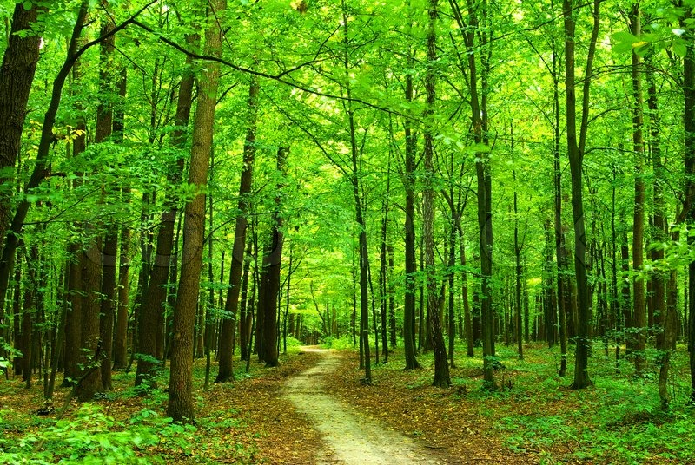
Journey Through The Woods
Decision Tree
Tuned Decision Tree
Bagged Tree
Random Forest
Tuned Random Forest
Stochastic Gradient Boost

Slide 3

My Very First Decision Tree
Parameters:
EVERYTHING defaulted
R²
Training: 99%
Test: 68%
RMSE
Training: ~ 0
Test: .2195

Slide 4

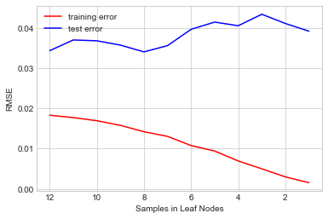
Tuned Decision Tree
Best Parameters
Max Depth: 11
Min Samples Leaf: 8
R²
Training: 91%
Test: 77%
RMSE
Training: .1192
Test: .1854
Grid Search Samples in Leaf Nodes
THOUGHTS: We have only fit the tree on one set of observations. Lower the variance by fitting the tree on MULTIPLE sets of observations using a Bagged Decision Tree.

Slide 5
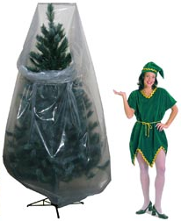
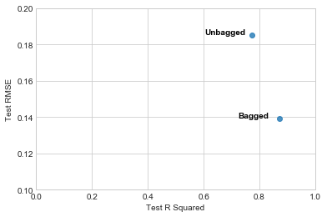
Bagged Tree
Improvement with Bagged Tree
Parameters
Trees: 500
Max Samples: 783
(2/3rds of training set)
R²
Training: 97%
OOB: 86%
Test: 87%
RMSE
Training: .0745
Test: .1394
THOUGHTS: Training and Test scores were improved but trees are too correlated as we are using the same set of parameters. Take subset of predictors at each split to decorrelate the trees using Random Forest.

Slide 6
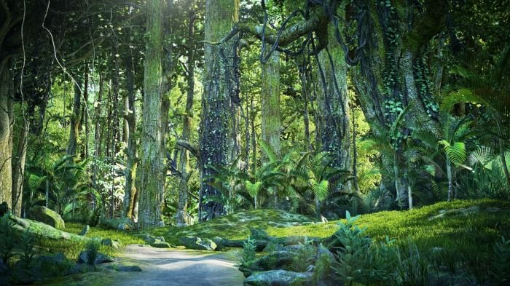
My Very First Random Forest
Parameters
Trees: 500
Max features: 17 (~ sqrt # of predictors)
R²
Training: 98%
OOB: 86%
Test: 87%
RMSE
Training: .0538
Test: .1397
THOUGHTS: Things barely changed (.0004 improvement in Test RMSE) in the results between the Bagged Tree and the Random Forest model. But what DID change were the importance to each predictor.

Slide 7
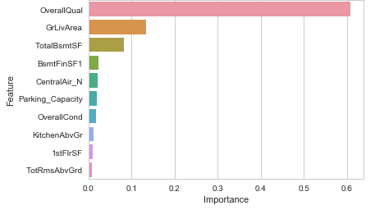
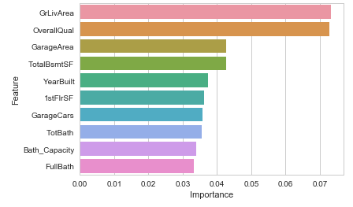
Top 10 Variable Importance Comparison
Correlated Trees (Bagged Tree)
Non Correlated Trees (Random Forest)

Slide 8
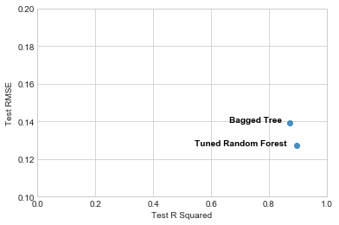
Tuned Random Forest (with GridSearchCV)
Improvement with Tuned Random Forest
Best Parameters
Trees: 500
Max Features: 36
R²
Training: 98%
OOB: 87%
Test: 88%
RMSE
Training: .0526
Test: .1361
THOUGHTS: Again, not much changed for the Training and Test R² . A .003 improvement in Test RMSE. What’s going on?

Slide 9
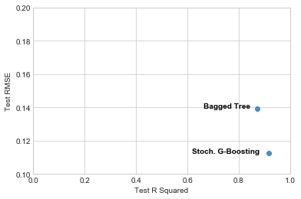

Stochastic Gradient Boosting
Parameters
Learning Rate: 0.1
Subsample: 2/3
Depth: 3
R²
Training: 96%
Test: 92%
RMSE
Training: .0835
Test: .1125
Improvement with Stoch. G-Boosting
THOUGHTS: Major improvements to the test scores and RMSE.
Test R² : 88% -> 92%
Test RMSE : .1361 -> .1125

Slide 10
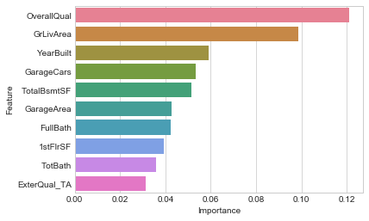
Tuned Stochastic Gradient Boosting (using GridSearchCV)
Best Parameters
Trees: 650
Learning Rate: 0.05
Subsample = 2/3
R²
Training: 99%
Test: 93%
RMSE
Training: .0454
Test: .1036
Final Top 10 Important Variables

